Slide 1


Oklahoma History Center
Social Story

Slide 2
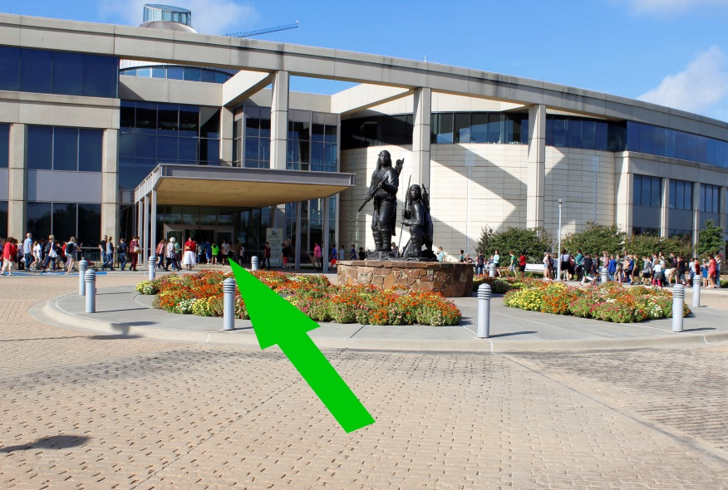
Arriving at the Oklahoma History Center
I am going to the Oklahoma History Center today!
As I drive in, I will see the Oil and Gas Park outdoor exhibit.
When I see this sculpture of two Apache warriors, I will know that I am here!
The entrance to the museum is just through those doors.

Slide 3
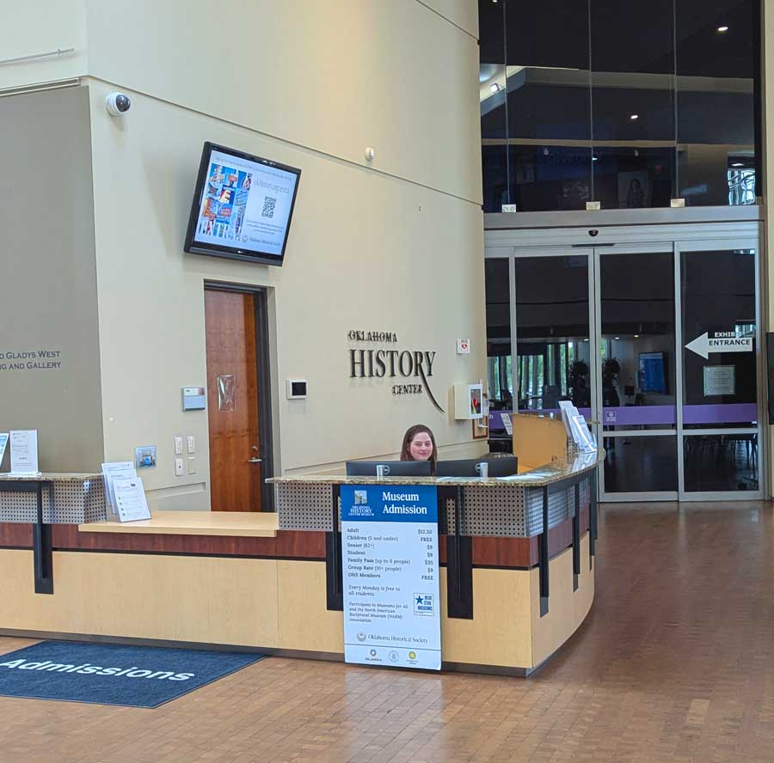
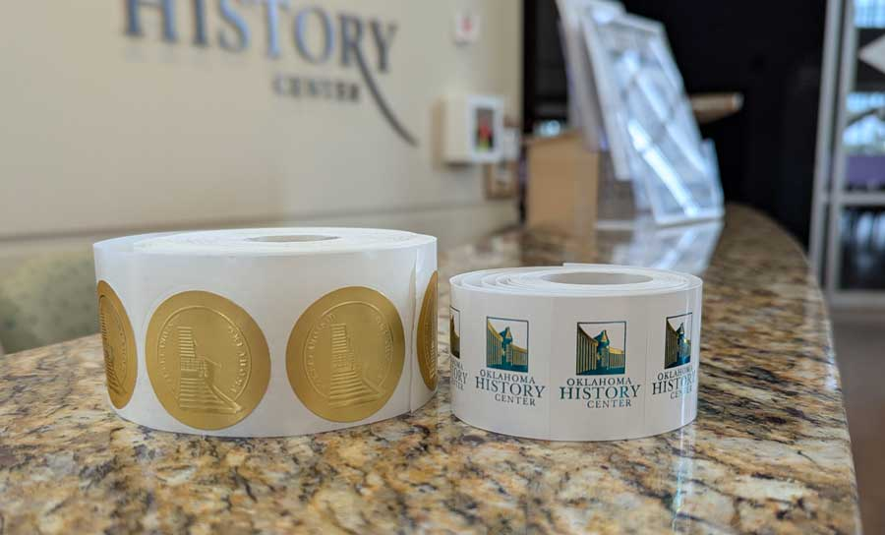
Admissions Desk
I will purchase tickets to the museum here.
I will receive a sticker to wear on my shirt while I am at the museum, and I may have to wait in line to buy my ticket.

Slide 4
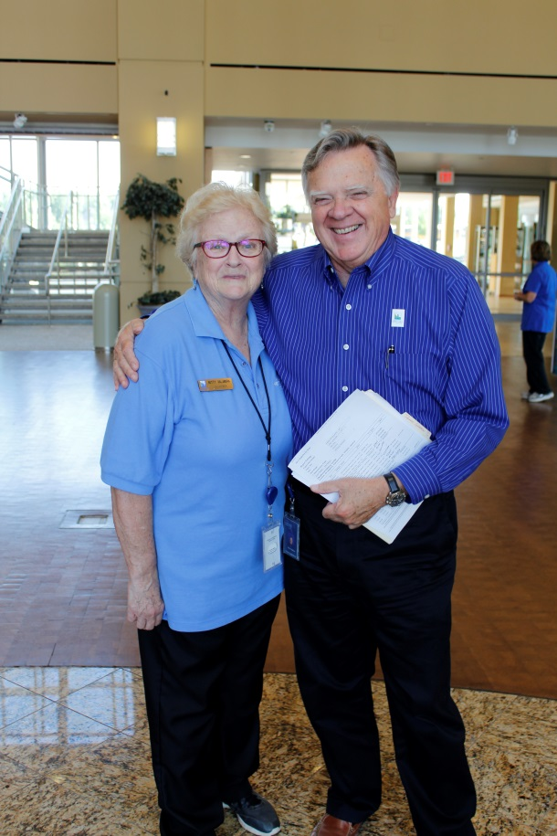
Volunteers and Staff
I might see a volunteer at the Oklahoma History Center. They wear a blue shirt and have a name tag.
Staff wear different types of clothing, but they all have name badges. Anyone with a blue shirt or a name badge can help me.

Slide 5
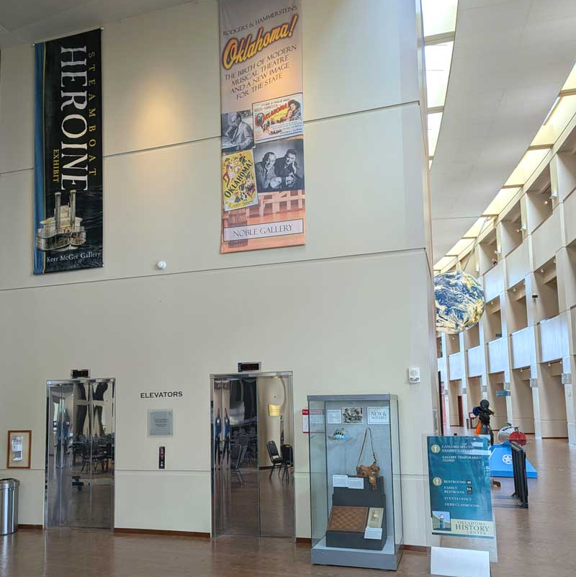
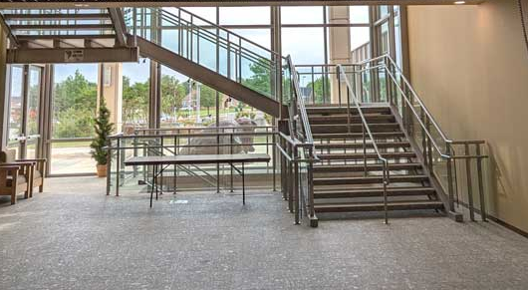
Elevators and Stairs
I can use the elevators, or I can take the stairs.
Galleries are on the first and third floors.

Slide 6
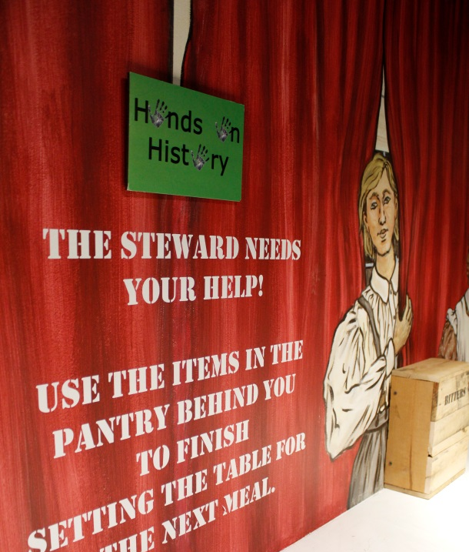

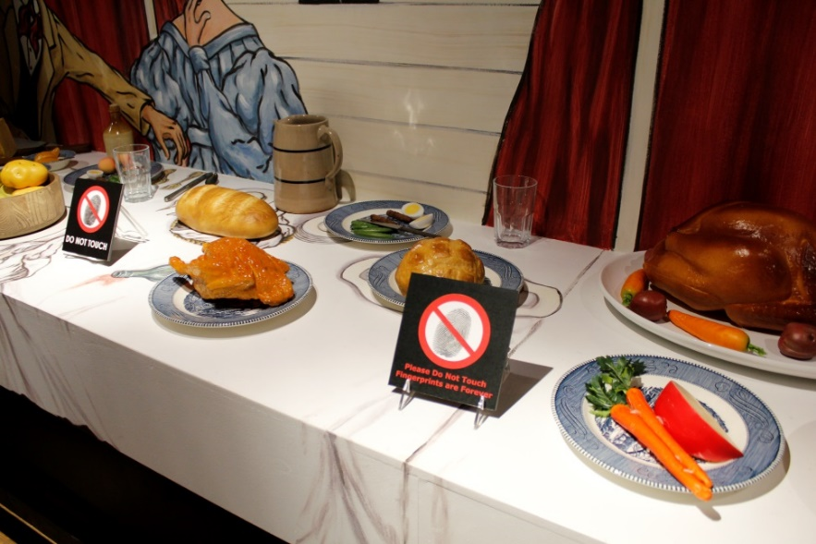
What I can and cannot touch
If I see a green sign, I know I can touch or play with these items. I will remember to be careful with anything I touch.
If I see a red sign, I cannot touch the items.
Sometimes these signs might be very close to each other.
I will see these signs in all the galleries.

Slide 7
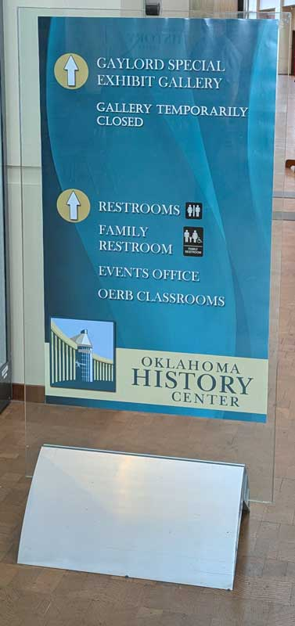
Restrooms and Signs
Restrooms can be found at the end of every hallway on all three floors.
I can look for signs that might help direct me to places in the museum.

Slide 8
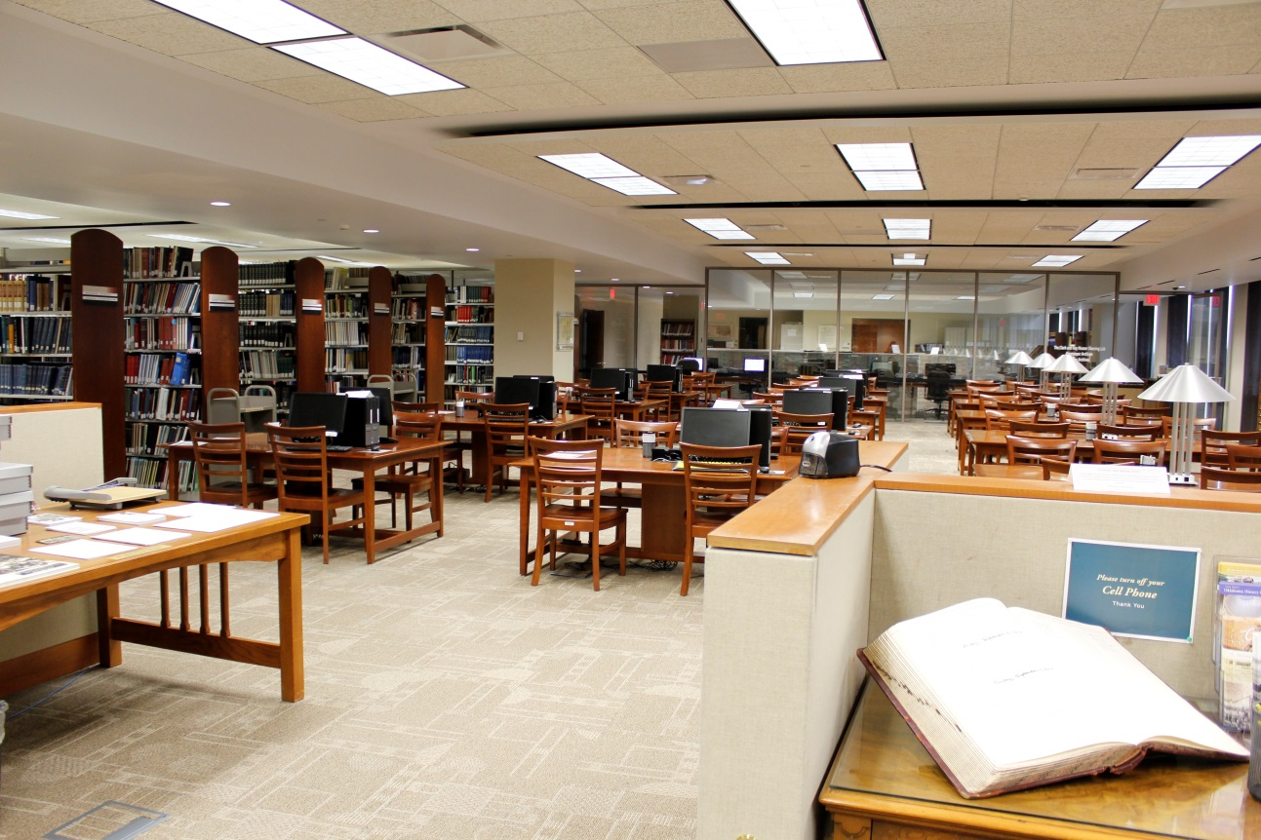
The Research Center Library
If I need a break or a quiet place, I can go to the library on the first floor.
I can sit there until I am ready to explore more.

Slide 9
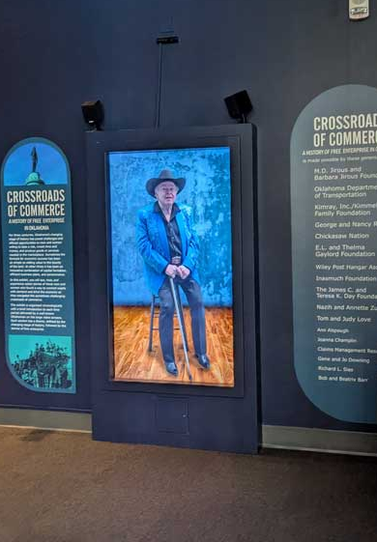
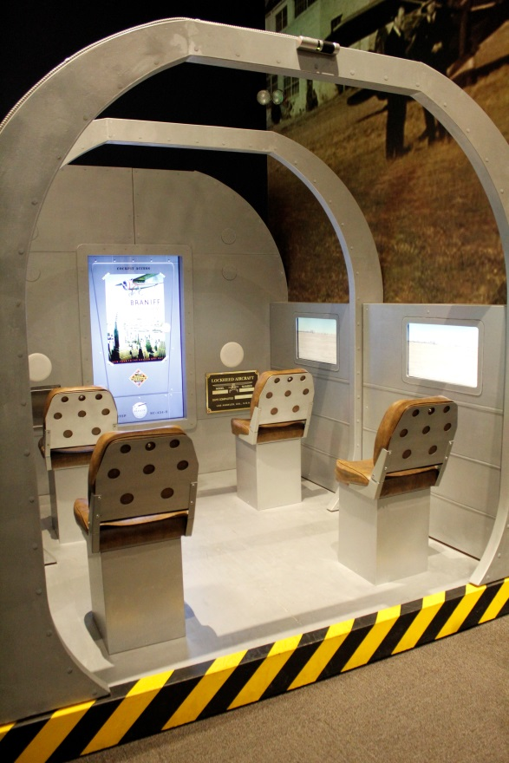
Inasmuch Gallery
In the Crossroads of Commerce exhibit, there is a large screen. When I step through the doors, a man will appear on the screen and start talking.
If I don’t like the sounds, I can leave the gallery. There are four more large screens like this in the gallery.
The airplane area in this gallery will let me experience the sights, sounds, and the feeling of taking off!

Slide 10
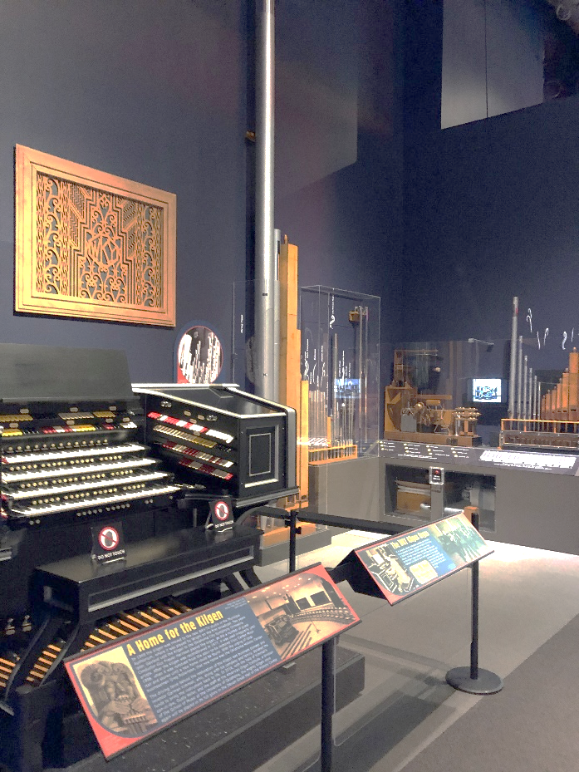
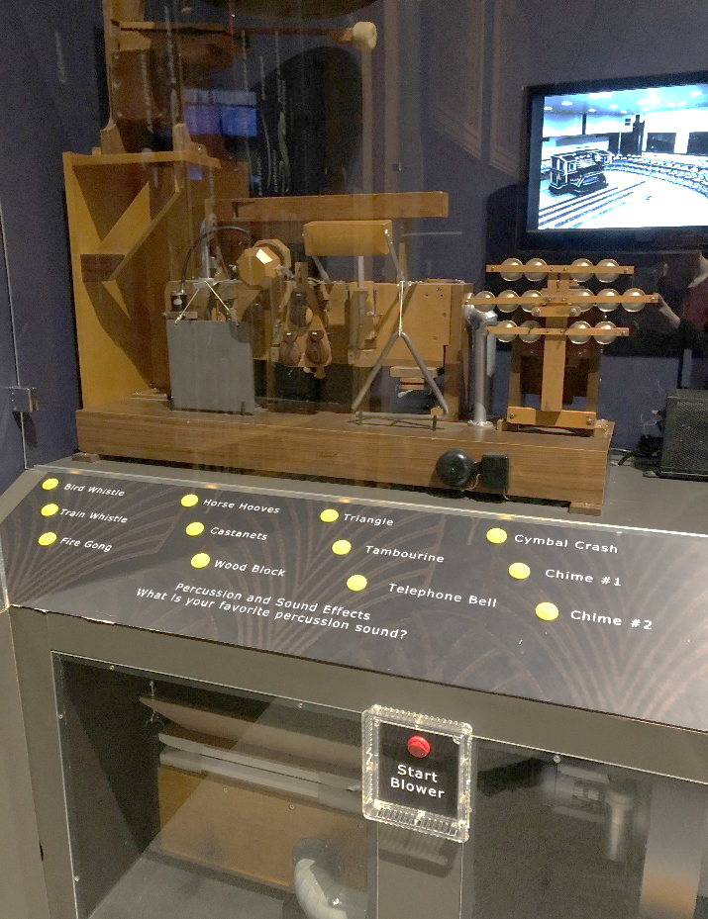
Theatre Organ Display and Sounds
There is a display in this gallery where I can see pipes and parts of a theatre organ. I can press buttons to hear the sounds an organ makes. The sounds may be very loud.
There will be many screens and sounds in the museum that may be very loud. I will be respectful of others when exploring these sounds.
Noise-reducing headphones are available at the front desk if I need to not hear so many loud sounds.

Slide 11
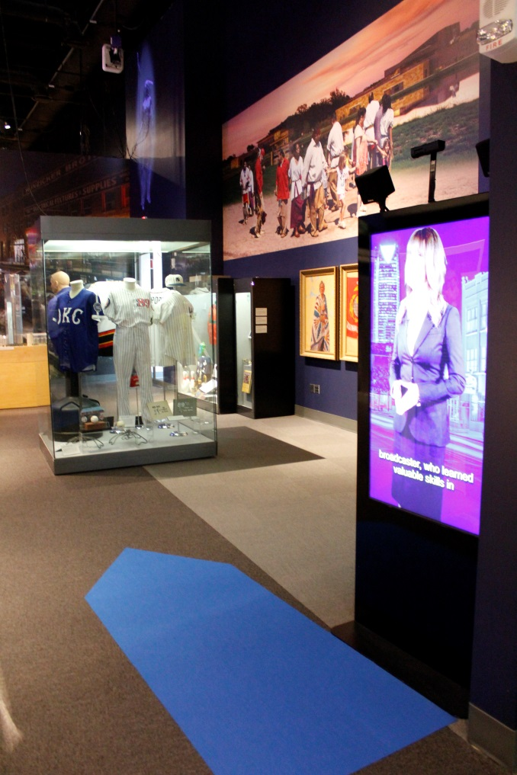
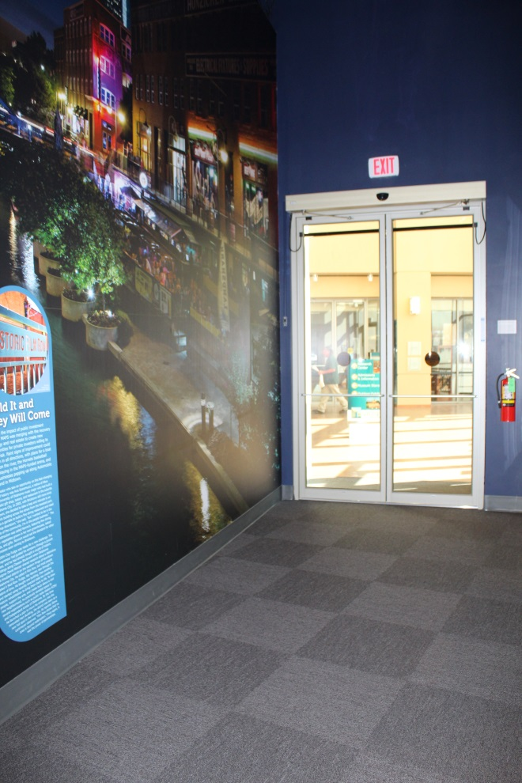
Walking through the Crossroads of Commerce Exhibit
I can find my way through the Crossroads of Commerce exhibit by looking for big colored arrows on the floor.
This gallery has its own exit.
I don’t have to turn around and go out the way I came in.

Slide 12
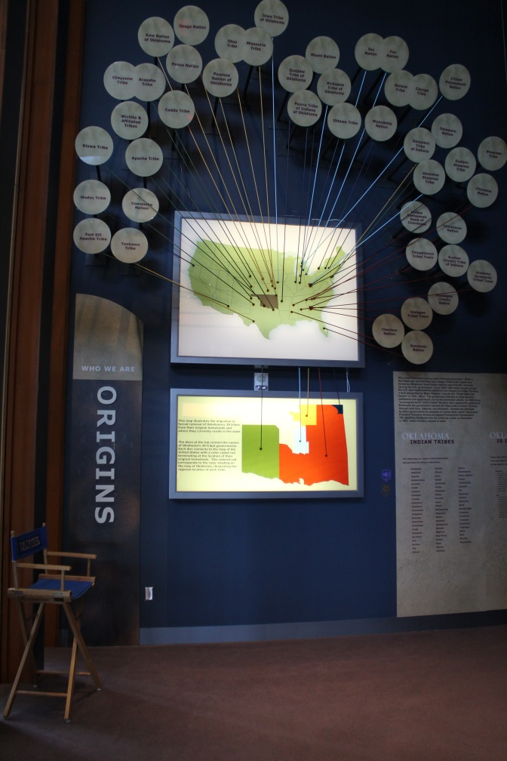
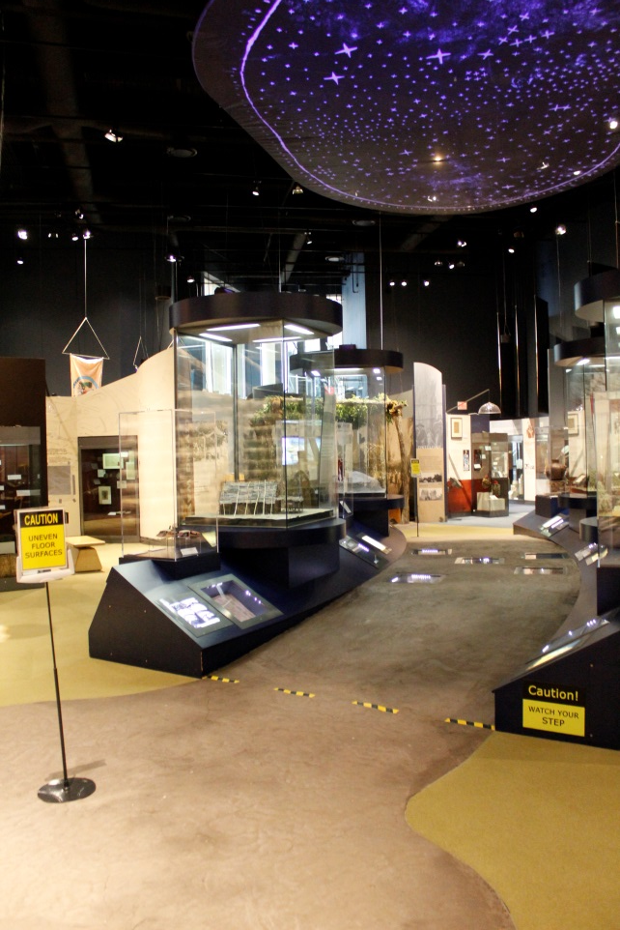
The ONEOK, Inc. Gallery
The American Indian exhibit is on the first floor. I will start by walking straight ahead where I see “Origins.”
I can turn right to the “Tribes” area, but that is meant to be the end of the exhibit.
I will be sure to look for raised or uneven floors and watch my step!

Slide 13
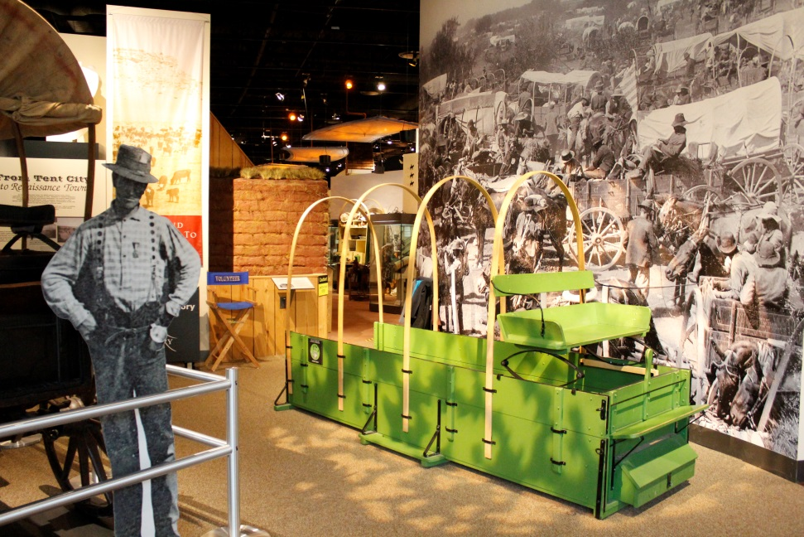
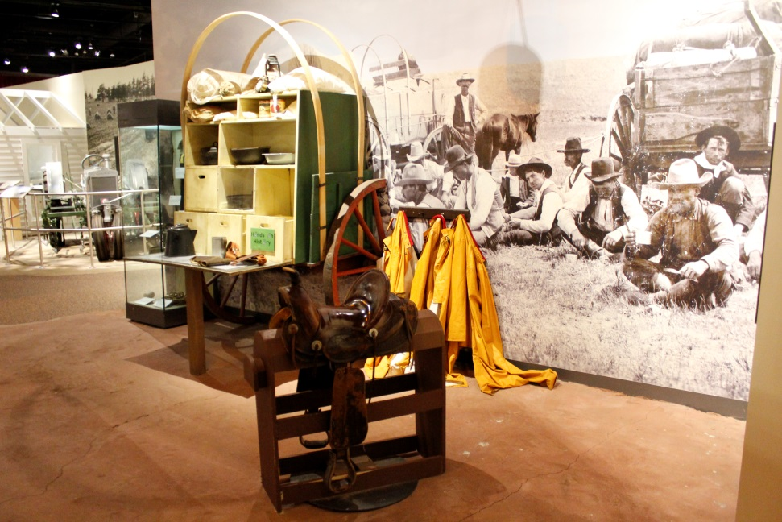
The Sam Noble Gallery
The Noble Gallery on the third floor has many places to explore and learn about early Oklahoma history. I will see exhibits on land runs, one-room schoolhouses, ranches, farming, law and order, and much more!
There are places in this gallery where I can sit on a saddle and pretend to work on a chuck wagon.

Slide 14
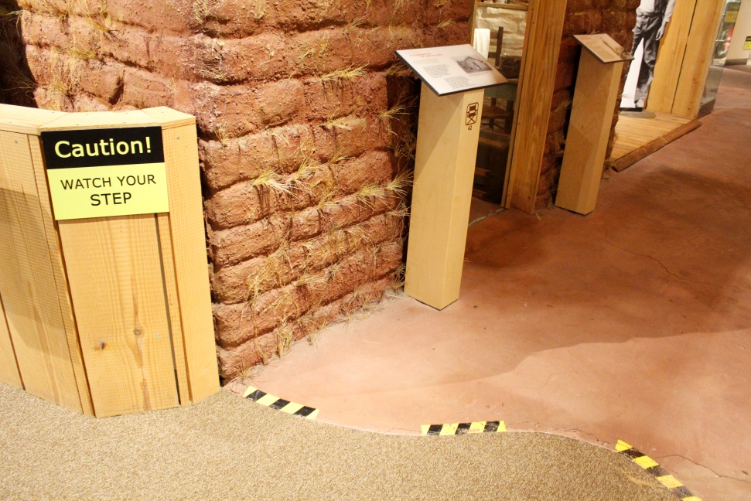
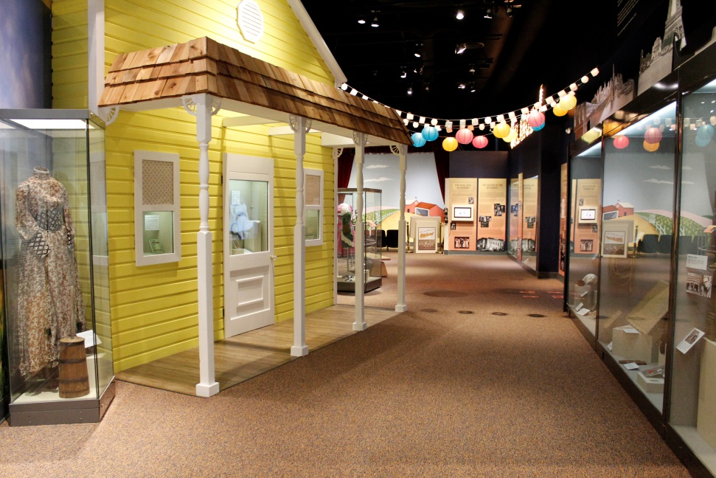
Other Exhibits in the Sam Noble Gallery
There are areas in this gallery with a raised or uneven floor. I will need to watch my step!
In this gallery, I will also find a pink kitchen and an exhibit about the musical Oklahoma!
This gallery has many paths to walk, but it’s okay to choose my own way.

Slide 15
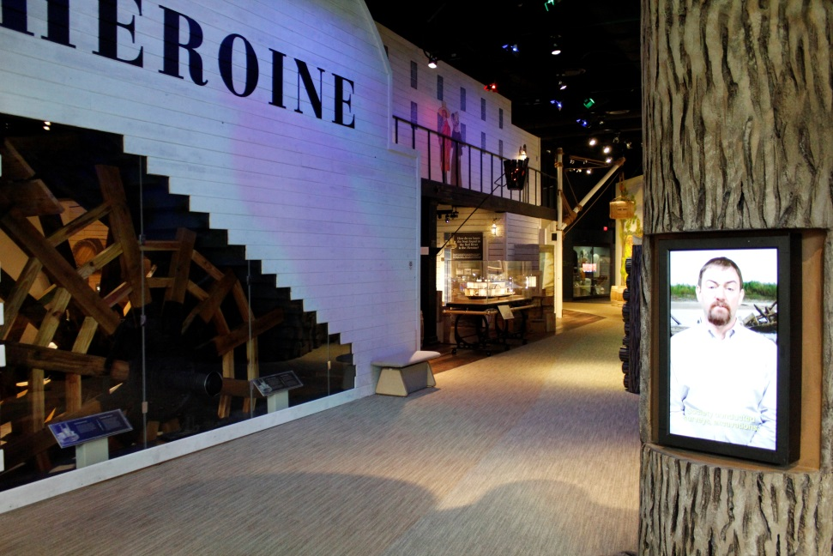
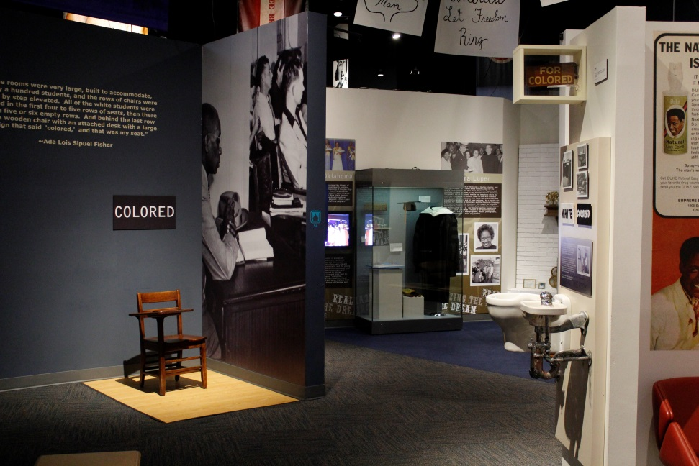
Kerr-McGee Gallery
In the Kerr-McGee Gallery, I will find exhibits about the steamboat Heroine, oil and gas, African American history, and Oklahomans who served in the military.

Slide 16
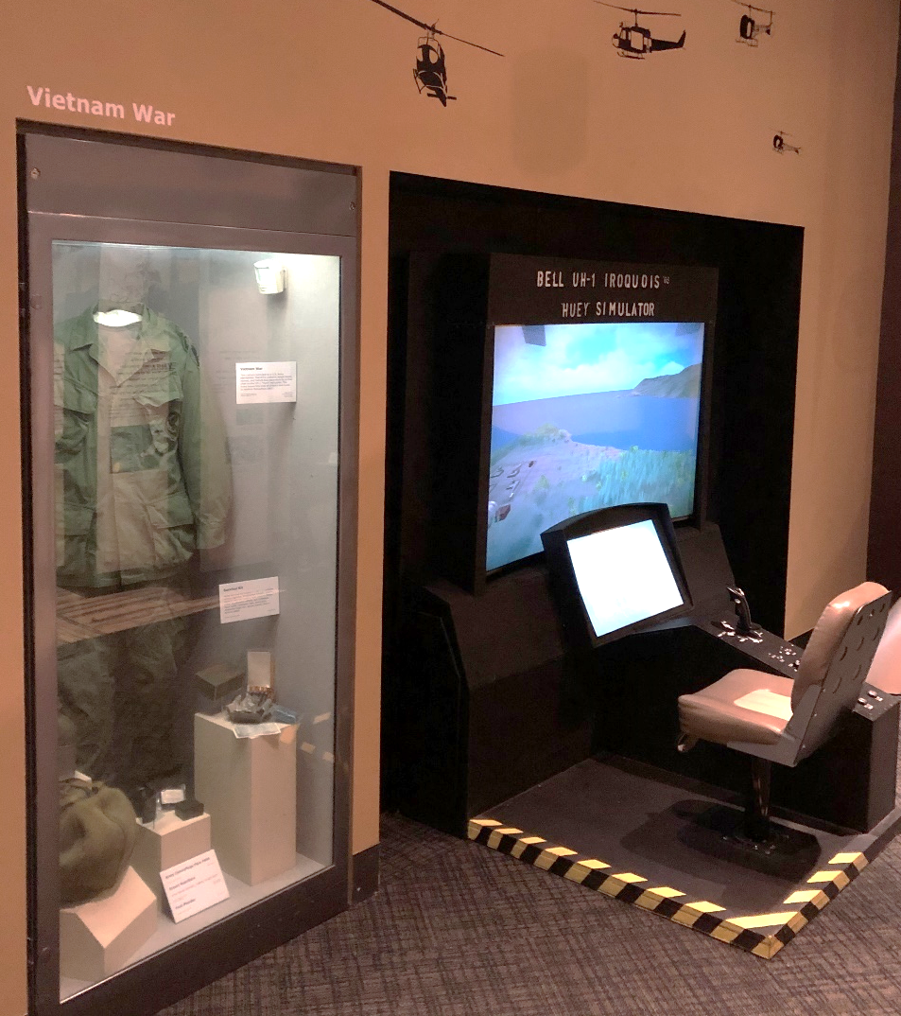
Military Exhibit
There is a fun game located in the military exhibit where I can pretend to fly a helicopter.
If someone else is playing the game, I will wait for my turn.

Slide 17
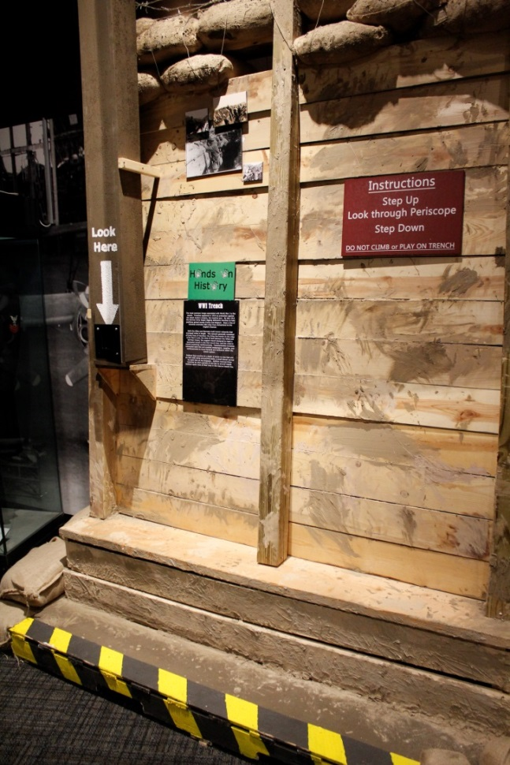
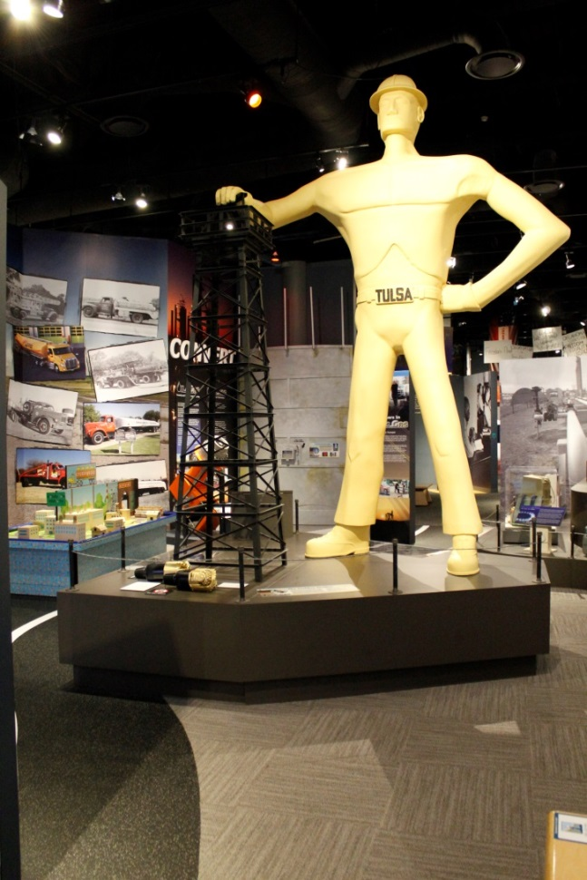
Military and Oil and Gas Exhibits
In the military exhibit, I will find something that looks like a trench (photo on the left). A trench is a deep hole in the ground where soldiers hid and fought during World War I.
I can look through the viewfinder and see other soldiers from across the field.
The yellow man in the oil and gas exhibit and is a smaller version of the real Golden Driller statue in Tulsa, Oklahoma!

Slide 18
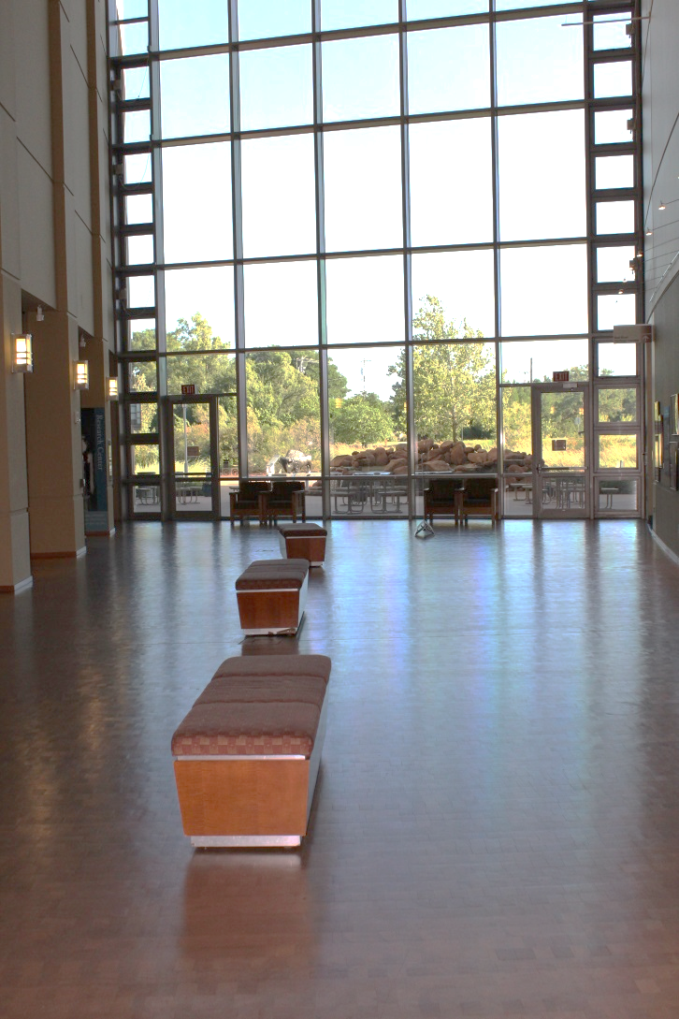
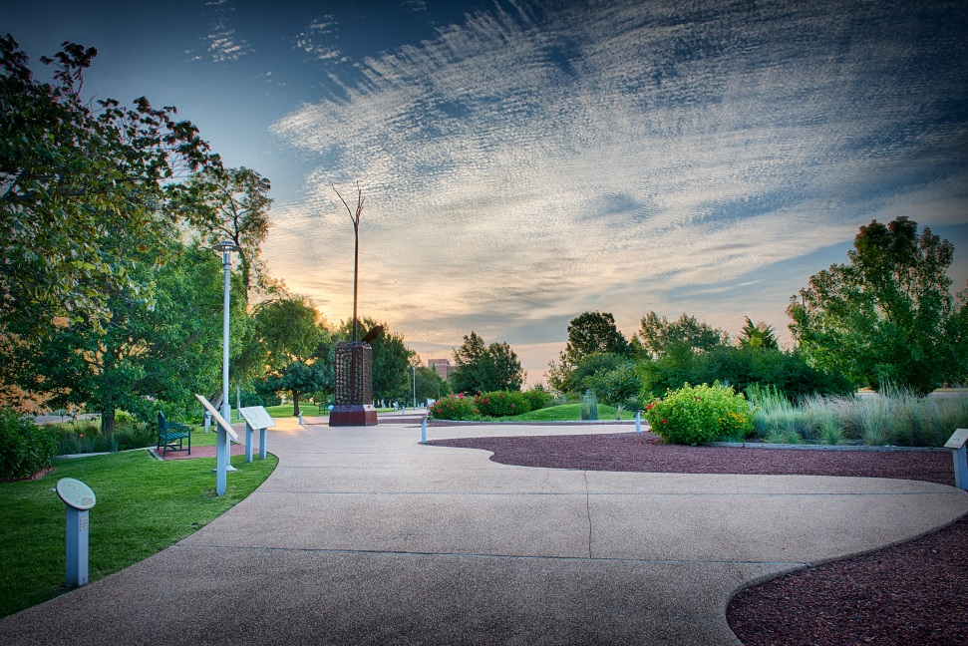
Going Outside and Other Areas
I can go outside to see more exhibits or just take a walk. There are picnic areas where I can eat my lunch if the weather is nice.
There are other areas in the building that I cannot go to, such as the offices.

Slide 19
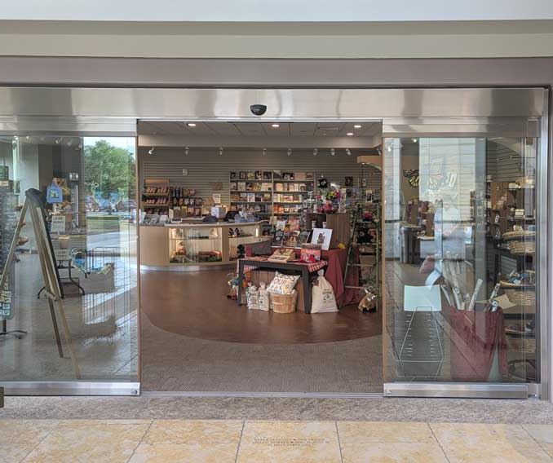
Museum Store
I can visit the Museum Store before I go home so that I can remember my trip to the Oklahoma History Center!

Slide 20
Rules to Remember
Some important rules to remember:
  I will stay with my adult and follow directions.
  I will speak quietly.
  I will not run.

Slide 21
Contact Us
Oklahoma History Center
800 Nazih Zuhdi Drive
Oklahoma City, OK 73105
www.okhistory.org

